Slide 1
Biotics 5 Prototype testing Milestone 2 Thursday, september 6, 2012 2:30 – 4:00 PM EST

Slide 2
Agenda
New Release – Milestone 2
Release Notes
Test Plan
Demo
Providing Feedback
Upcoming schedule
Discussion/Questions
Notes:
Biotics 4
Living with Aging system
Compatibility issues in new environments (Windows, Oracle)
Other common problems (DM comments)
Phasing out Biotics 4 – Support will continue through FY13 and be phased out in FY14 (discuss with Lori)
Four stages;
Market introduction / General Availability (2003- 2004)
Growth/Extended (2004 – 2010)
Maturity (2010 – 2013)
No new versions or patches
Standard support provided (helpdesk and email)
Continued expansion of online information and Knowledgebase
With release of Biotics 5 in 2013 we will enter the last 12 month of this stage
Limited support provided (helpdesk and email)
New environments not certified
Few updates to online information (i.e., Knowledgebase)
Saturation and decline/Retired (2014) – final phase of Biotics 4
Standard helpdesk and email support ends
Access to very limited support through Biotics 4 online help archives

Slide 3
Release Notes & Testing
Release Notes
Test Plan
Search text (ctrl-F)
Copy & Paste
Testing
Clear your cache!
Notes:
Biotics 4
Living with Aging system
Compatibility issues in new environments (Windows, Oracle)
Other common problems (DM comments)
Phasing out Biotics 4 – Support will continue through FY13 and be phased out in FY14 (discuss with Lori)
Four stages;
Market introduction / General Availability (2003- 2004)
Growth/Extended (2004 – 2010)
Maturity (2010 – 2013)
No new versions or patches
Standard support provided (helpdesk and email)
Continued expansion of online information and Knowledgebase
With release of Biotics 5 in 2013 we will enter the last 12 month of this stage
Limited support provided (helpdesk and email)
New environments not certified
Few updates to online information (i.e., Knowledgebase)
Saturation and decline/Retired (2014) – final phase of Biotics 4
Standard helpdesk and email support ends
Access to very limited support through Biotics 4 online help archives

Slide 4
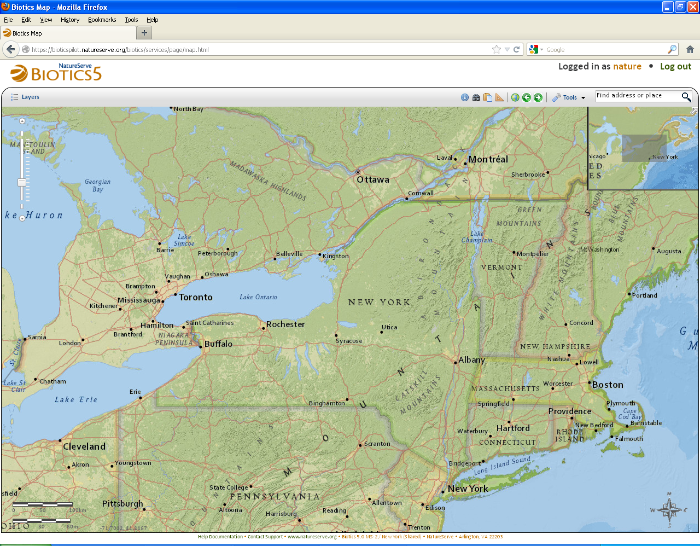
Milestone 2 Demo

Slide 5
Providing Feedback

Slide 6
What you have reported
Issues identified by Pilot Programs – Resolved
BX-71: Measure tool not displaying resulting measurement in IE 8
BX-72: Indicate when a filter has been applied to a layer with ‘(Filtered)’ next to layer name.
BX-74: Indicate that Feature Search (map viewer) criteria populated within collapsed sections
BX-75: Library Layers not displayed in IE
BX 76: In IE, within Feature Search window, ‘Select’ button badly positioned
BX-77: In IE, Feature Search Result tab not populating
BX-79: Report measure distance as line being drawn in Measure tool
BX-84: Filter & Search buttons look grayed out
BX-107: Add Zoom To Layer option to layer menu
BX-108: Only show currently visible layers in legend
BX-115: Removing SF from list still adds it to an EO

Slide 7
What you have reported
Issues identified by Pilot Programs – Open
BX-78: Remember Measure Unit setting or allow default setting to be configured
BX-104: Provide distance measurement while digitizing SF Line
BX-113: Indicate search has been completed in Filter Layer Search by providing count
BX-116: Improvements to Choose Principal EO window
BX-120: Add reference scale to scale bar

Slide 8
Providing Feedback – the latest guidelines
Submit Tickets regarding:
Bugs
Improvements
Feature Requests
Questions
Use Forums to:
Vote on Feature Requests
Add Tips & Tricks

Slide 9
Providing Feedback
Submitting Tickets:
Be specific about the tool which you’re commenting on
Indicate which web browser you’re using (IE, Google, Firefox)
Provide screenshots
Include the page URL – important as it includes pertinent Record Number data
Issues approved for further development:
Awaiting Development:
Status: Pending Substatus: Development
Implemented by Development
Status: Resolved (See Release Notes)

Slide 10
Upcoming Schedule
Scheduled maintenance tonight: 7 – 8 PM Eastern
Milestone 3 release:
Thursday, October 4
2:30 – 4:00 PM Eastern
Spatial configuration details – possible interim meeting
User-suggested topics:
If you have a specific topic you would like us to cover in an upcoming meetings let us know preferably no later than the week prior to that meeting

Slide 11
Discussion/Questions

