Slide 1
Biotics 5 Prototype testing Milestone 3 Thursday, october 4, 2012 2:30 – 4:00 PM EST

Slide 2
Agenda
New Release – Milestone 3
Release Notes
Test Plan
New Documentation
Demo
Providing Feedback
Upcoming schedule
Discussion/Questions
Notes:
Biotics 4
Living with Aging system
Compatibility issues in new environments (Windows, Oracle)
Other common problems (DM comments)
Phasing out Biotics 4 – Support will continue through FY13 and be phased out in FY14 (discuss with Lori)
Four stages;
Market introduction / General Availability (2003- 2004)
Growth/Extended (2004 – 2010)
Maturity (2010 – 2013)
No new versions or patches
Standard support provided (helpdesk and email)
Continued expansion of online information and Knowledgebase
With release of Biotics 5 in 2013 we will enter the last 12 month of this stage
Limited support provided (helpdesk and email)
New environments not certified
Few updates to online information (i.e., Knowledgebase)
Saturation and decline/Retired (2014) – final phase of Biotics 4
Standard helpdesk and email support ends
Access to very limited support through Biotics 4 online help archives

Slide 3
Release Notes & Testing
Release Notes
Test Plan
New documentation
Testing
Clear your cache!
Notes:
Biotics 4
Living with Aging system
Compatibility issues in new environments (Windows, Oracle)
Other common problems (DM comments)
Phasing out Biotics 4 – Support will continue through FY13 and be phased out in FY14 (discuss with Lori)
Four stages;
Market introduction / General Availability (2003- 2004)
Growth/Extended (2004 – 2010)
Maturity (2010 – 2013)
No new versions or patches
Standard support provided (helpdesk and email)
Continued expansion of online information and Knowledgebase
With release of Biotics 5 in 2013 we will enter the last 12 month of this stage
Limited support provided (helpdesk and email)
New environments not certified
Few updates to online information (i.e., Knowledgebase)
Saturation and decline/Retired (2014) – final phase of Biotics 4
Standard helpdesk and email support ends
Access to very limited support through Biotics 4 online help archives

Slide 4
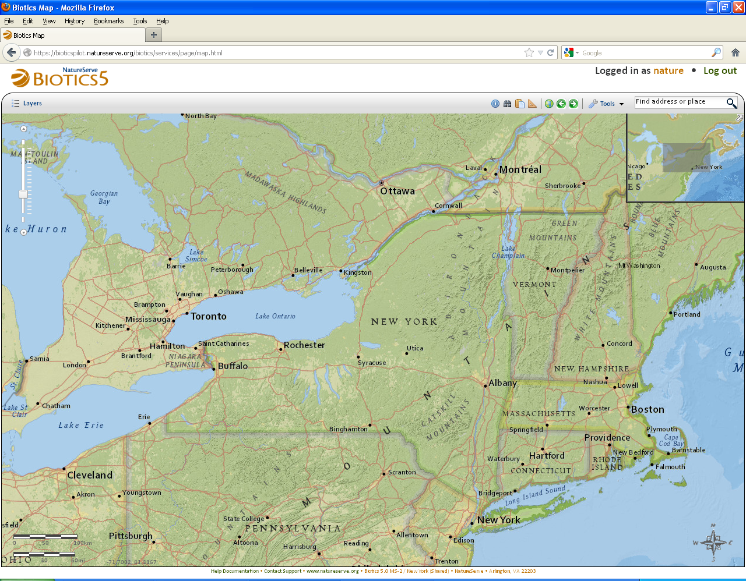
Milestone 3 Demo

Slide 5
Providing Feedback

Slide 6
What you have reported
Issues identified by Pilot Programs – Resolved
BX-120: Add reference scale to scale bar
BX-131: Drawing toolbar redo operation can remove entire drawing
BX-161: Indicate which drawing tools are modes and which are one-time use tools
BX-201: Increase size of feature Details window
BX-207: Feature Search: expand Get Unique Values section so data can be read
BX-234: Improve performance of drawing tools
BX-284: Security error occurs when trying to delete EOs
BX-291: Cannot create EO for Elements that do not already have at least one EO

Slide 7
What you have reported
Issues identified by Pilot Programs – Open
BX-46: Feature Search in map viewer fails when trying to ‘Get Unique Values’
BX-78: Remember Measure Unit setting or allow default setting to be configured
BX-89: Snap to feature using Measure tool
BX-90: Add Zoom By tool or ability to configure Find Location tool
BX-99: Add keep-alive heartbeat to map viewer and other pages
BX-104: Provide distance measurement while digitizing SF Line
BX-109: Identify only works on first layer in multi-layer map service
BX-112: Add Flash option to Source Feature and Sub-EO section within EO Details
BX-113: Indicate search has been completed in Filter Layer Search by providing count
BX-116: Improvements to Choose Principal EO window
BX-120: Add reference scale to scale bar
BX-148: Filter Layer – make Service a dropdown list

Slide 8
What you have reported
Issues identified by Pilot Programs – Open
BX-156: Ability to save and apply saved filters
BX-167: Save current extents and layers
BX-170: Legend formatting – left justify text
BX-172: Symbolize layers
BX-176: Add fields to EO working list
BX-178: Add new field to Site search window and working list
BX-181: Select fields that user can see in results or working list
BX-183: Record maintenance page improvements
BX-188: Make map tools always available
BX-191: Add functionality to jump to EOR from ESR or CAS record
BX-196: Populate Details windows from Oracle views not used elsewhere by application
BX-197: Labeling features on map

Slide 9
What you have reported
Issues identified by Pilot Programs – Open
BX-198: Improve legend aesthetics
BX-203: Format the Identify Results
BX-204: basemaps… can we turn them off?
BX-255: Improvements to Source Features to include in Proposed EO window
BX-260: error in Test Plan
BX-282: adding shapefiles & other spatial layers to map viewer
BX-283: Export managed layers to shapefile
BX-290: record format
BX-294: Add graphic to map to indicate location
BX-295: When SF removed from EO, reassess separation distance and indicate if SFs no longer within originally specified SD
BX-296: Modify Shape: Point & Line – tries to edit polygonal shape rather than original feature

Slide 10
Upcoming Schedule
Network release:
Wednesday, October 24th, 2:30 – 4:00 PM Eastern
Thursday, October 25th, 2:30 – 4:00 PM Eastern
Milestone 4 release:
Thursday, November 8th
2:30 – 4:00 PM Eastern
Spatial configuration details – possible interim meeting
User-suggested topics:
If you have a specific topic you would like us to cover in an upcoming meetings let us know preferably no later than the week prior to that meeting

Slide 11
Discussion/Questions

