Slide 1
Biotics 5 Prototype testing Milestone 5 Thursday, december 6, 2012 2:30 – 4:00 PM EST

Slide 2
Agenda
New Release – Milestone 5
Release Notes
Test Plan
Demo
Providing Feedback
Vote on Topics within the Feature Requests Forum
Upcoming schedule
Discussion/Questions
Notes:
Biotics 4
Living with Aging system
Compatibility issues in new environments (Windows, Oracle)
Other common problems (DM comments)
Phasing out Biotics 4 – Support will continue through FY13 and be phased out in FY14 (discuss with Lori)
Four stages;
Market introduction / General Availability (2003- 2004)
Growth/Extended (2004 – 2010)
Maturity (2010 – 2013)
No new versions or patches
Standard support provided (helpdesk and email)
Continued expansion of online information and Knowledgebase
With release of Biotics 5 in 2013 we will enter the last 12 month of this stage
Limited support provided (helpdesk and email)
New environments not certified
Few updates to online information (i.e., Knowledgebase)
Saturation and decline/Retired (2014) – final phase of Biotics 4
Standard helpdesk and email support ends
Access to very limited support through Biotics 4 online help archives

Slide 3
Release Notes & Testing
Release Notes
Test Plan
Testing
Clear your cache!
Notes:
Biotics 4
Living with Aging system
Compatibility issues in new environments (Windows, Oracle)
Other common problems (DM comments)
Phasing out Biotics 4 – Support will continue through FY13 and be phased out in FY14 (discuss with Lori)
Four stages;
Market introduction / General Availability (2003- 2004)
Growth/Extended (2004 – 2010)
Maturity (2010 – 2013)
No new versions or patches
Standard support provided (helpdesk and email)
Continued expansion of online information and Knowledgebase
With release of Biotics 5 in 2013 we will enter the last 12 month of this stage
Limited support provided (helpdesk and email)
New environments not certified
Few updates to online information (i.e., Knowledgebase)
Saturation and decline/Retired (2014) – final phase of Biotics 4
Standard helpdesk and email support ends
Access to very limited support through Biotics 4 online help archives

Slide 4
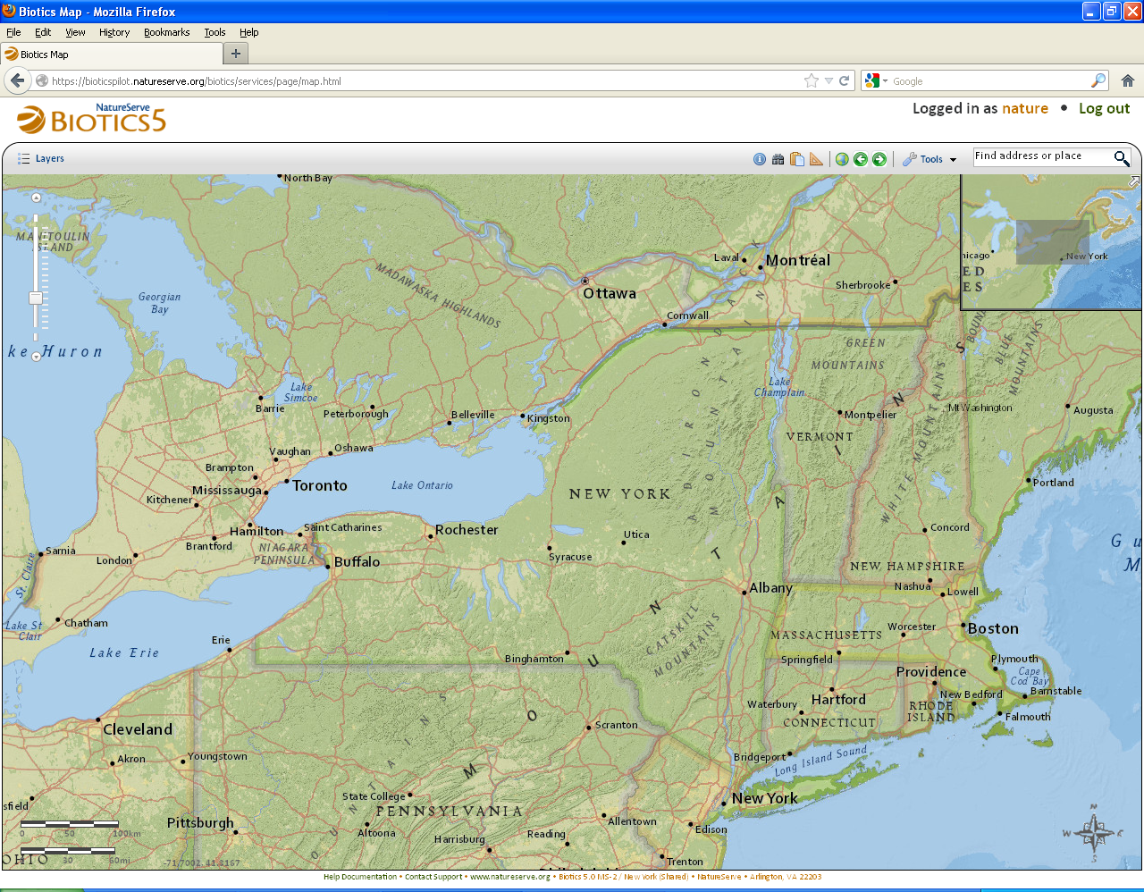
Milestone 5 Demo

Slide 5
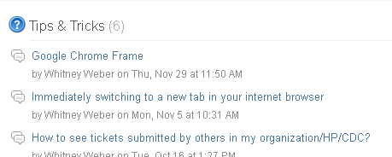
Providing Feedback

Slide 6
What you have reported
Resolved
BX-116: Add EO_NUM to Choose Principal EO window and rename Unattached SFs to Independent SFs
BX-183: Adjust layout on record pages to prevent 2nd column labels from appearing to describe 1st column values
BX-255: Improvements to “Source Features to Include in Proposed EO” dialog
BX-327: Provide message when attempting to view an empty list of records through “Source Features to Include in Proposed EO” dialog
BX-462: Get Unique Values no longer providing results
BX-481: Move arrow graphic pointing to “details for selected row” so it does not overlap text
BX-492: Workflow for creating a new EST from an existing EGT doesn't work in IE 8

Slide 7
What you have reported
Issues Submitted since the last meeting - Open
BX-468: Provide a more useful tooltip when hovering over a link to another record
BX-469: Provide an auto-complete text box as a quicker alternative when searching for elements
BX-470: Remove 'Add to List' button in search dialogs when only a single item can be selected
BX-471: Use a more intuitive icon for the drawing toolbar's crop tool
BX-472: Show popup messages for a longer duration
BX-473: Close Buffer Tool after clicking Buffer
BX-474: Move shape, undo edit - shape returns but vertices don't
BX-475: newly created SF disappears after clicking NEXT on Draw/Edit toolbar
BX-478: Update tooltips used for drawing toolbar buttons

Slide 8
What you have reported
Issues Submitted since the last meeting - Open
BX-479: Allow users to access a log file for popup messages
BX-480: Do not automatically collapse map resources trees when clicking to show/hide layers
BX-482: Request continuous toggle through search results
BX-493: Show more than 10 records in a search result window
BX-500: Confirm Navigation upon exiting map viewer
BX-513: Window size for Spatial clipboard
BX-514: Spatial Clipboard Scrolling issue

Slide 9
Vote on Topics within the Feature Requests Forum
State in EO Working List?
Survey Site in EO Working List?
Conservation Site in EO Working List?
Biodiversity Significance as search field in (Conservation) Site search window
Inconsistent deletion message for grid rows
“Confirm Navigation” upon exiting map viewer

Slide 10
Upcoming Schedule
Milestone 6 release:
Thursday, January 10th
2:30 – 4:00 PM Eastern
User-suggested topics:
If you have a specific topic you would like us to cover in an upcoming meetings let us know preferably no later than the week prior to that meeting

Slide 11
Discussion/Questions

