Slide 1
Biotics 5 Prototype testing Milestone 6 Thursday, january 10, 2012 2:30 – 4:00 PM EST

Slide 2
Agenda
New Release – Milestone 6
Release Notes
Test Plan
Demo
Development & Milestone Release Plan
Providing Feedback
Upcoming schedule
Discussion/Questions
Notes:
Biotics 4
Living with Aging system
Compatibility issues in new environments (Windows, Oracle)
Other common problems (DM comments)
Phasing out Biotics 4 – Support will continue through FY13 and be phased out in FY14 (discuss with Lori)
Four stages;
Market introduction / General Availability (2003- 2004)
Growth/Extended (2004 – 2010)
Maturity (2010 – 2013)
No new versions or patches
Standard support provided (helpdesk and email)
Continued expansion of online information and Knowledgebase
With release of Biotics 5 in 2013 we will enter the last 12 month of this stage
Limited support provided (helpdesk and email)
New environments not certified
Few updates to online information (i.e., Knowledgebase)
Saturation and decline/Retired (2014) – final phase of Biotics 4
Standard helpdesk and email support ends
Access to very limited support through Biotics 4 online help archives

Slide 3
Release Notes & Testing
Release Notes
Test Plan
Testing
Clear your cache!
Notes:
Biotics 4
Living with Aging system
Compatibility issues in new environments (Windows, Oracle)
Other common problems (DM comments)
Phasing out Biotics 4 – Support will continue through FY13 and be phased out in FY14 (discuss with Lori)
Four stages;
Market introduction / General Availability (2003- 2004)
Growth/Extended (2004 – 2010)
Maturity (2010 – 2013)
No new versions or patches
Standard support provided (helpdesk and email)
Continued expansion of online information and Knowledgebase
With release of Biotics 5 in 2013 we will enter the last 12 month of this stage
Limited support provided (helpdesk and email)
New environments not certified
Few updates to online information (i.e., Knowledgebase)
Saturation and decline/Retired (2014) – final phase of Biotics 4
Standard helpdesk and email support ends
Access to very limited support through Biotics 4 online help archives

Slide 4
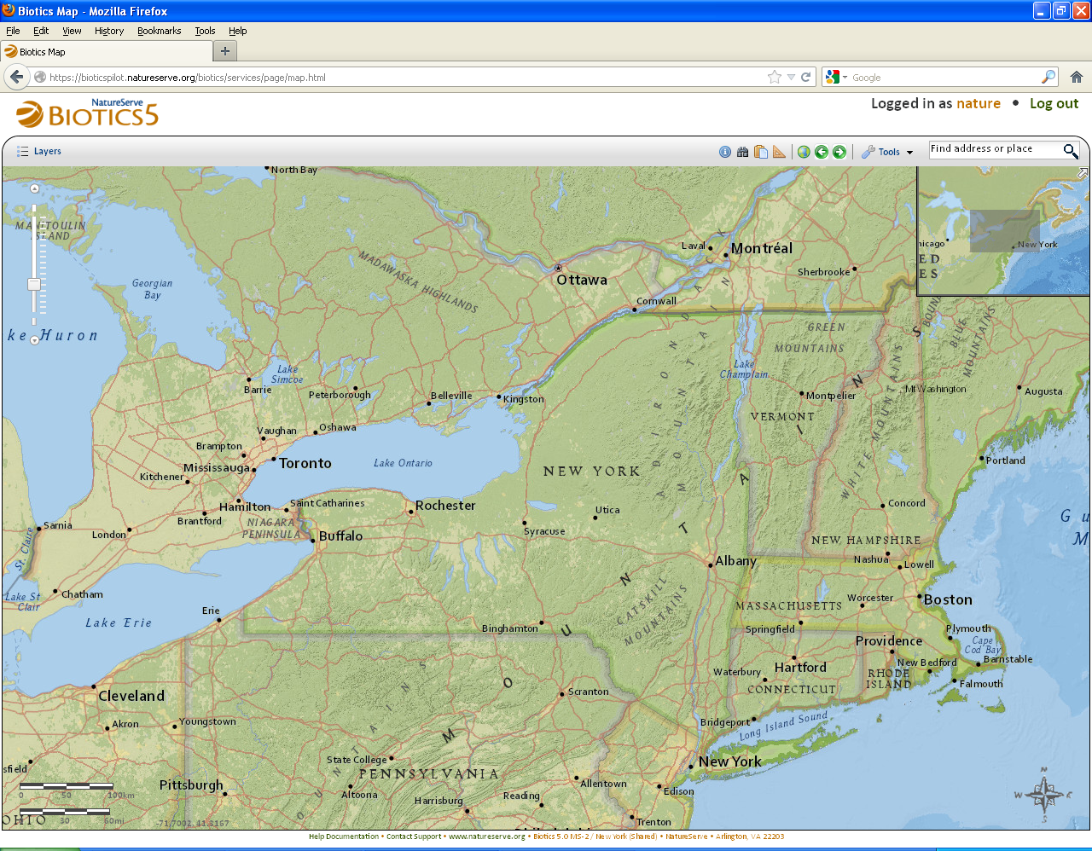
Milestone 6 Demo

Slide 5
Development & Milestone Release Plan
Month | Milestone | Functionality
January | MS – 6 | Performance enhancements & usability improvements New record pages for National and Global Ranking, EO Rank Specs, EO Specs Map viewer bug fixes Support for custom projections User profile management Remaining record page types Complete process requirements for data exchange
February | MS – 7 | Begin implementation for editing SFs and EOs Implement navigation between SFs and EOs on the map viewer Design architecture for spatial attribute calculations Design architecture for archiving shapes Design workflow for editing SFs and EOs Design data exchange implementation
March | MS-8 | Finish implementation of editing SFs and EOs Implement spatial attribute calculations Implement archiving shapes Implement spatial support for conservation sites and equisites Data exchange prototype

Slide 6
Development & Milestone Release Plan
Month | Milestone | Functionality
April - June | MS 9 – 11 Specifics of each milestone - TBD | Remaining record page types Improve drawing toolbars User management and security configuration Administrative functionality Finish data exchange Batch import/export Support for other map services (WMS, Feature Services, Image Services, KML, etc) Observation integration Observation workflow (generating SFs, propagating changes to SFs and EOs,) Printing Saving and initializing to map states Bookmarking places Customizing the spatial library Uploading, viewing, and working with shape files
June | Public Release Candidate | End of June: start making public release available

Slide 7
Providing Feedback

Slide 8
What you have reported
Resolved
BX-88: Change cursor when selecting rows from search result dialogs
BX-399: Buffer Tool gives error when buffering point and line SFs
BX-413: "When creating a Source Feature: the Locational Uncertainty Type options are not indented when Conceptual Feature Type is Point or Line"
BX-475: newly created SF graphic disappears during final steps of SF creation workflow
BX-480: Do not automatically collapse map resources trees when refreshing its state
BX-531: Review Related Record navigation menus for all implemented records
BX-536: Improve speed of opening records
BX-540: The Previous button on the Separation Distance Comments dialog does not work when creating a new EO using only Independent SFs
BX-541: Location section is not shown for a new EO
BX-547: "Change default in Feature Search to NOT have ""Immediately Show Details"" indicated"
BX-549: Error message - Identifying Watershed & Quad layers

Slide 9
What you have reported
Issues Submitted since the last meeting - Open
BX-565: Problem with initial order of Element Search results
BX-566: Navigating through records of same type
BX-594: Change placement of “Open records in list” function

Slide 10
Upcoming Schedule
Milestone 7 release:
Thursday, February 7th
2:30 – 4:00 PM Eastern
User-suggested topics:
If you have a specific topic you would like us to cover in an upcoming meetings let us know preferably no later than the week prior to that meeting

Slide 11
Discussion/Questions

