Slide 1
Biotics 5 development priorities – issues - 2017 Thursday, march 30, 2017 2:00 – 3:00 PM EdT

Slide 2
Survey Results
Respondents: 39 of 51 – 76%
Other: if you suggested an ‘Other’ development issue for which you have not submitted a ticket, submit a ticket!
Implementation of 2016 Survey Results
Map Issues
Non-Map Issues
Prioritization of Development Efforts
Upcoming Webinars

Slide 3
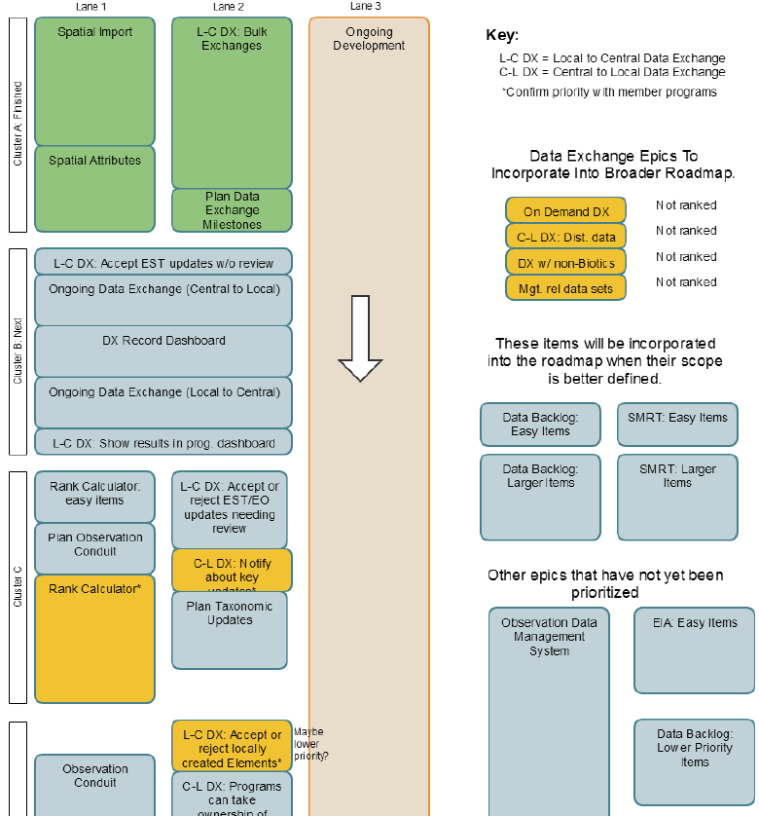
Biotics Roadmap
Outlines Development Priorities of epics (broad areas of development which require significant time/effort)
Updated with every new release to reflect progress
Description provided for each epic in details
30 responses to Biotics 5 Development Priorities – Roadmap survey
Detailed responses to the Roadmap survey can be found in the Development Priorities solutions, here.
For more information on interpreting the roadmap and for details on each roadmap item see the Biotics Roadmap solution within the Biotics 5 Help Desk
Notes:
Coming in December – Biotics Roadmap Review webinar

Slide 4
Implementation of 2016 Survey Results
Key | Summary | Component | Release Version | Rank in Survey | Number of Tickets
BX-676 | Implement ability to batch import SF shapes & link to existing unmapped SF data records (Link Source Features) | Map Viewer | 5.8 | 8 | 12
BX-820 | Bulk import Managed Areas | Map Viewer | 5.8 | 16 | 13
BX-821 | Bulk import conservation Sites | Map Viewer | 5.8 |  | 15
BX-1184 | Bulk import via geodatabase | Map Viewer | 5.8 |  | 15
BX-1346 | Implement ability to link shapes to unmapped Managed Area/Site records | Map Viewer | 5.8 | 6 | 12
BX-1318 | Allow bulk import of all data associated with a SF during bulk creation of Source Features | Map Viewer | 5.8.2 | 1 | 13
BX-1303 | Increase ArcGIS Server limit for records returned from Feature Search and Filter | Map Viewer | 5.8.4 | 3 | 5
BX-379 | Implement the ability to administer extensible tables | Configuration | 5.8.4 | 3 (Non-Map) | 2
BX-167 | Save map viewer state: current center point, scale, layers, filters | Map Viewer | 5.9 | 5 | 7
BX-402 | Implement the ability for users to create, manage, and use geographic bookmarks | Map Viewer | 5.9 | 17 | 15
BX-2125 | Enable Crystal Reports via Biotics (i.e. Print from record & WL) | Record & WL | 5.9.2 | 1 (Non-Map) | 11
BX-1370 | Customize attributes displayed in Identify/Feature Search/Filter tools and exported shapefiles using Join Fields | Map Viewer | 5.9.4 | 4 | 35
BX-1192 | Export to geodatabase (from both Map & Query Builder) | Map & Query Builder | 5.9.5 | 13 | 7

Slide 5
Map Issues
Development Issue | Rank | # of Tickets | Version Implemented
BX-172: Allow individual users to change symbology for managed layers and also other map services that would support this behavior | 1 | 19
BX-101: Allow feature map services to be utilized in Map viewer | 2 | 5 | 5.9.6
BX-156: Implement ability to save and apply saved filters to Map Resources | 3 | 20
BX-1821: Allow Zoom to Coordinates and Identify tools to be used simultaneously (previously supported) | 4 | 6 | 5.9.6
BX-972: improve measure tool | 5 | 15 | 5.9.6
BX-294: Allow users to add graphics to the map | 6 | 10
BX-1297: Create Working List from filtered layer | 7 | 10
BX-1461: Add option to Apply Add/Remove to/from Include List to All Selected dialog | 8 | 5
BX-405: Allow OGC Web Map Service (WMS) to be utilized in Map | 9 | 5
BX-1115: modifying shape of large, complex shape returns "Warning: Unsresponsive Script" multiple times (bioticsVA, bioticsFL, bioticsNE) | 10 | 4
BX-1252: Alter symbology of uploaded shapefiles to cycle through a color ramp | 11 | 11
BX-1182: Implement ability to add KML files to Map | 12 | 4
BX-90: Add Zoom By tool or ability to configure Find Location tool | 13 | 12
BX-2644: Make headings sortable in Map's Attribute table | 14 | 5
BX-1149: Export to Shapefile - All layers | 15 | 11
BX-197: Allow individual users to dynamically label managed layer | 16 | 5
BX-46: Feature Search in Map fails when trying to 'Get Unique Values' | 17 | 4 | 5.9.6
BX-819: Implement a quick search/filter for managed layers | 18 | 5
BX-1484: Update managed layers Details dialog to all the record being viewed to be added to a Working List | 19 | 5

Slide 6
Non-Map Issues
JIRA Issue | Rank | # of Tickets
BX-2273: Allow programs to customize data entry screens (EO in particular) | 1 | 16
BX-181: Allow programs or users to customize the columns shown for search results and working lists | 2 | 18
BX-1418: Add specimen table to Source Feature | 3 | 17
BX-2252: Create online replacement for rank calculator spreadsheet | 4 | 13
BX-2140: Add tool to show table relationships within Biotics | 5 | 6
BX-1286: Need Change Associated Element option for SFs | 6 | 7
BX-2239: Turn TAXON_[G-N-S]_RANK_CHANGES extensible table into standard fields that automatically populate | 7 | 5
BX-381: Implement the ability save and reuse search criteria | 8 | 6
BX-420: Replicate "Record maintenance" and "Attribute Maintenance" functionality from Biotics 4, which provide access to the current record's audit log | 9 | 8
BX-828: Show more Working Lists & list items per page | 10 | 8
BX-1116: Provide an automated way to populate Distribution grids in subnational characterization (CAS) records | 11 | 5
BX-1250: Implement Contacts screen and enable Contacts grids in related records | 12 | 5
BX-1665: Increase non-spatial search results limit to 1000 | 13 | 8
BX-380: Implement the ability to administer customizable domain tables | 14 | 5
BX-537: Add "Go To Record" functionality | 15 | 5
BX-440: Text/background color options to reduce eye strain | 16 | 5
BX-664: Ability to add multiple search results to a grid at once | 17 | 4
BX-1434: Allow hyperlinks in text fields | 18 | 6
BX-1715: Improve performance when loading records with large numbers of grid rows | 19 | 5
BX-1642: Service Unavailable error displayed frequently when Grant/Refresh Database Privileges run | 20 | 5

Slide 7
Prioritization of Development Efforts
Factors:
Defect, critical fix
Whether there’s a workaround
Number of programs affected
Survey rank
Number of associated tickets
Logical order (i.e. fixing something else in same component)
Level of Effort
Notes:
Question 22

Slide 8
Upcoming Webinars
Data Manager Session @ BWB:
Tuesday, April 11
10:30am – 12pm Eastern
Biotics 5.9.6 Release Webinar:
Thursday, April 20
2 – 3 pm Eastern

Slide 9
Discussion/Questions

