Slide 1
Biotics 5 Prototype testing Milestone 7 Thursday, February 7, 2012 2:30 – 4:00 PM EST

Slide 2
Agenda
New Release – Milestone 7
Release Notes
Test Plan
Demo
Rank Calculator Usage
Development & Milestone Release Plan Discussion
Providing Feedback
Upcoming Schedule
Discussion/Questions
Notes:
Biotics 4
Living with Aging system
Compatibility issues in new environments (Windows, Oracle)
Other common problems (DM comments)
Phasing out Biotics 4 – Support will continue through FY13 and be phased out in FY14 (discuss with Lori)
Four stages;
Market introduction / General Availability (2003- 2004)
Growth/Extended (2004 – 2010)
Maturity (2010 – 2013)
No new versions or patches
Standard support provided (helpdesk and email)
Continued expansion of online information and Knowledgebase
With release of Biotics 5 in 2013 we will enter the last 12 month of this stage
Limited support provided (helpdesk and email)
New environments not certified
Few updates to online information (i.e., Knowledgebase)
Saturation and decline/Retired (2014) – final phase of Biotics 4
Standard helpdesk and email support ends
Access to very limited support through Biotics 4 online help archives

Slide 3
Release Notes & Testing
Release Notes
Test Plan
Testing
Clear your cache!
Notes:
Biotics 4
Living with Aging system
Compatibility issues in new environments (Windows, Oracle)
Other common problems (DM comments)
Phasing out Biotics 4 – Support will continue through FY13 and be phased out in FY14 (discuss with Lori)
Four stages;
Market introduction / General Availability (2003- 2004)
Growth/Extended (2004 – 2010)
Maturity (2010 – 2013)
No new versions or patches
Standard support provided (helpdesk and email)
Continued expansion of online information and Knowledgebase
With release of Biotics 5 in 2013 we will enter the last 12 month of this stage
Limited support provided (helpdesk and email)
New environments not certified
Few updates to online information (i.e., Knowledgebase)
Saturation and decline/Retired (2014) – final phase of Biotics 4
Standard helpdesk and email support ends
Access to very limited support through Biotics 4 online help archives

Slide 4
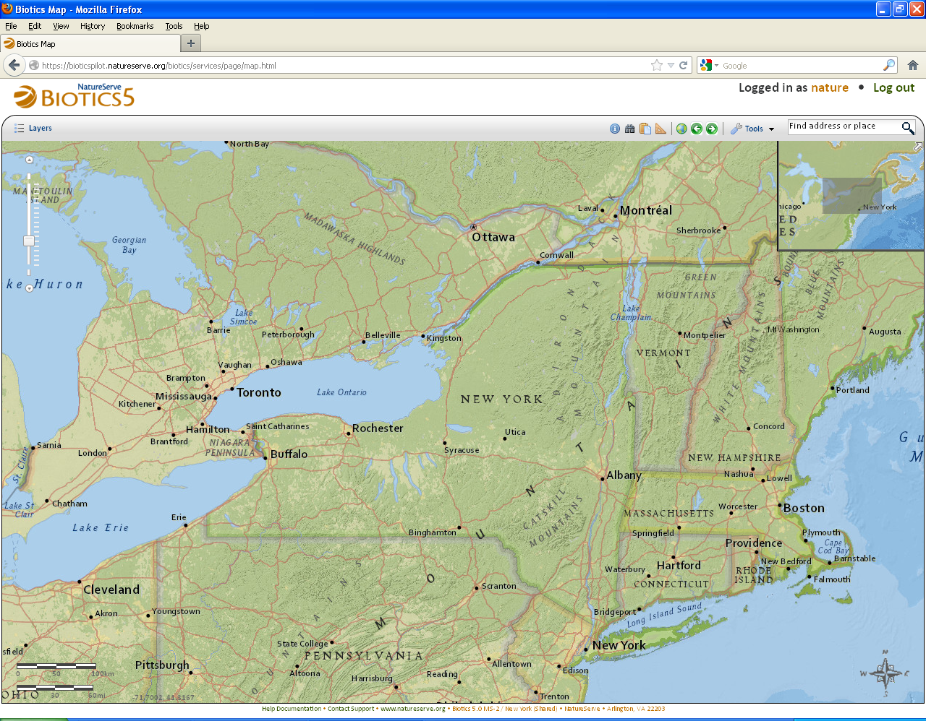
Milestone 7 Demo

Slide 5
Use of Rank Calculator

Slide 6
Rank Calculator and Biotics 5
Fields and domain values that are included in the Rank Calculator but not currently in Biotics 4 will be incorporated into Biotics 5
Each program’s current use of the Rank Calculator will have to be determined so we can develop steps to transfer it to Biotics 5 accurately and efficiently
Pilot Programs: Please answer the following questions to give us a sample of the situations in the network.

Slide 7
Rank Calculator Usage
Have you been using the Rank Calculator?
If yes, do you have data stored in the Rank Calculator that should go into Biotics?
If yes, do you have multiple Rank Calculator spreadsheets? Are they different versions of the calculator?
Have you brought any data from the Rank Calculator back into Biotics?
If yes, what have you done with AOO and Trends data, where the domain values differ between the calculator and Biotics 4?
Have you created any extensible tabs to house data from the Rank Calculator for fields not in Biotics 4?

Slide 8
Development & Milestone Release Plan
Month | Milestone | Functionality
March | MS-8 | Modify EOs Implement spatial attribute calculations Implement archiving and retrieving shapes Finalize data exchange requirements
April | MS-9 | Implement spatial support for conservation sites and equisites Drawing Toolbar improvements for copying and editing shapes Integrate map viewer tasks with topics within Help Documentation Implement additional record pages for program data (i.e. Characterization Abstracts)
May | MS-10 | Export data Bulk import Source Features (not including create as EO process) Add data layers from your client machine to map viewer Implement additional Central record pages and data model changes Manage Ecoregions
June | MS -11 | Add support for other map services Implement ability to display layers from configured set within Spatial Library Feature Details Results – display records in tabular format Custom map views - save /restore custom map configurations Search by spatial attribute User management, security setup Basic Query Builder tool Implement limited Data Exchange functionality Database Integrity Check

Slide 9
Tasks to Prioritize for Development Plan
Support for importing Observations as basis for SFs
Bulk Import:
Create EOs from bulk imported SFs
Managed Areas
Sites
Administer Custom Map Views
Zoom By tool
Print map
Add Oracle Attributes to managed features
Link shape to unmapped data record
Save and apply saved filters
Quick filter for managed layers
Dynamic symbology for managed layers
Support for Geographic Bookmarks
Spatial attributes: recalculate all features
Implement full Data Exchange functionality
Spatial attributes: recalculate selected features
Bulk deletion – initiated from map viewer
Bulk Deletion – initiated from tabular record
Save and open working lists in map viewer
Administration: Configure Spatial Library (Navigator)
Administration: Configure Spatial Attributes
Administration: Configure Extensible tables
Administration: Configure Domain values
Administration: Configure Zoom-By-Layers
View Element Groups
Reports: external (i.e. Crystal Reports)
Save search criteria
Refine Searches
Integrate Rank Calculator functionality

Slide 10
Providing Feedback

Slide 11
What you have reported
Resolved
BX-112: Add Flash option to Source Feature and Sub-EO section within EO Details
BX-145: Add option to delete or unlink SFs when deleting EO
BX-146: Add drawing tool: add shape of a feature selected from the spatial clipboard
BX-178 Add new field to Site search window and working list
BX-296: Modify Shape for points and line tries to edit polygonal shape rather than pre-Source Feature
BX-325: All users to zoom to specific scales
BX-470: Remove ‘Add to List’ button in search dialogs when only a single item can be selected
BX-474: Move shape, undo edit – shape returns but vertices don’t
BX-565: Problem with initial order of Element Search results
BX-607: Deletion of SF hangs
BX-609: Legend should reflect various values within D_NAME_CATEGORY table

Slide 12
What you have reported, cont’d
Resolved
BX-653: Reference search not working for MA Element addition
BX-656: Clicking on value within Get Unique Values does not populate SELECT statement within Filter dialog
BX-669: Biotics freezes when trying to open Search window after initially saving new working list in primary window

Slide 13
What you have reported
Issues Submitted since the last meeting - Open
BX-601: Add a ? Icon to each of the Map Viewer dialogs to link directly to the applicable help topic in the Help Documentation
BX-602: Add survey site column to EO working list
BX-635: Implement ability to digitize a point by entering coordinates
BX-641: Implement Reevaluate EO workflow
BX-654: Add ability to create records from Search windows
BX-660: Top navigation menus open underneath map viewer dialogs
BX-664: Ability to add multiple search results to a grid at once
BX-665: Add a column and change width of MA Elements grid
BX-677: Save selected features to working list

Slide 14
Upcoming Schedule
Biotics 5 Network Demo – Milestone 7
Wednesday, February 13th
2:30 – 3:30 PM Eastern
Thursday, February 14th
2:30 – 3:30 PM Eastern
Milestone 8 release:
Thursday, March 7th
2:30 – 4:00 PM Eastern

Slide 15
Discussion/Questions
Individual program assignments

