Slide 1
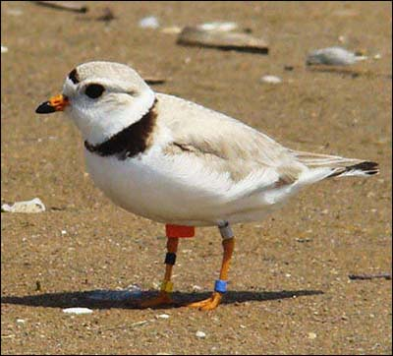
Automating the Assignment of SF IDs and EO IDs when Preparing a Dataset for Bulk Import
Molly Moore, GIS Specialist
Pennsylvania Natural Heritage Program
January 24, 2019

Slide 2
Bulk Create
Pros
Improved efficiency for large, uncomplicated datasets
Cons
Time-consuming data preparation
Notes:
Bulk create capabilities have improved the efficiency of entering large datasets into Biotics. However, time-consuming data preparation steps require data managers to weigh whether the time needed to prepare a dataset is worth the ability to bulk load the features rather than just create them manually.
In Pennsylvania, we have been developing standardized methods by which to increase the efficiency of data preparation for use with the bulk create feature in Biotics.

Slide 3
Separation Distance Analysis

Slide 4
Separation Distance Analysis

Slide 5
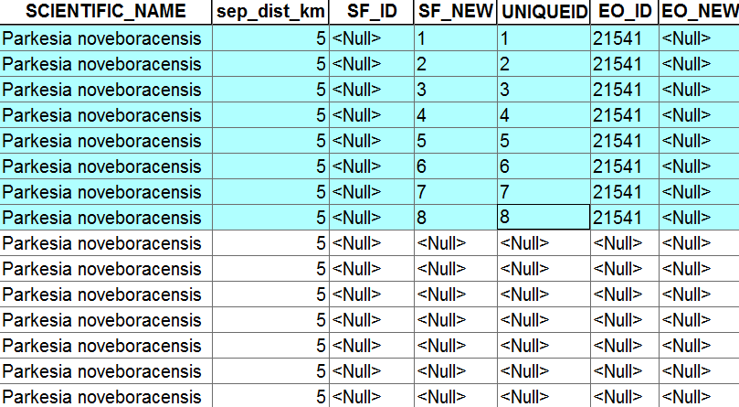
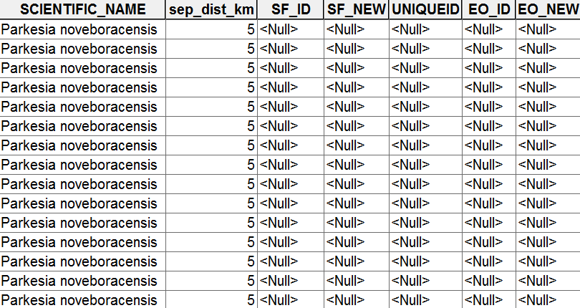
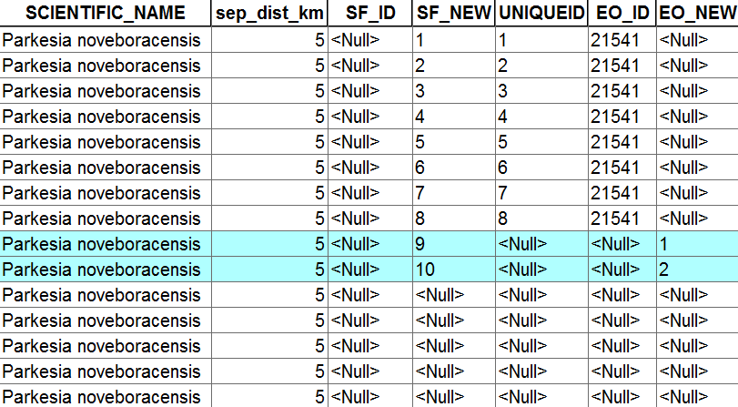
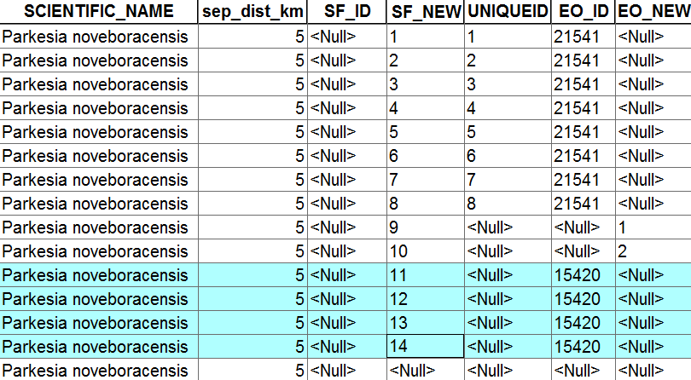
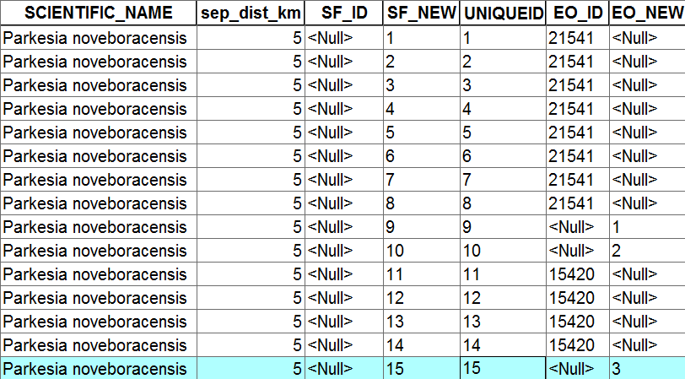
Separation Distance Analysis

Slide 6
Advantages of Manual EO/SF Grouping
Extra QC
Identification of separation barriers
Can distinguish between suitable/unsuitable habitat separation distances
Disadvantages of Manual EO/SF Grouping
Potential for human error
Time consuming

Slide 7
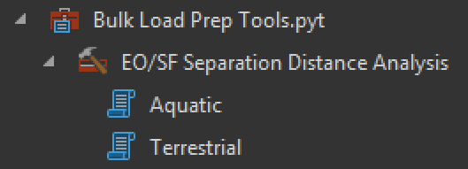
Python Toolbox

Slide 8
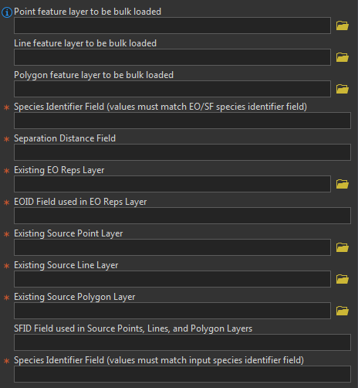
Input Parameters

Slide 9
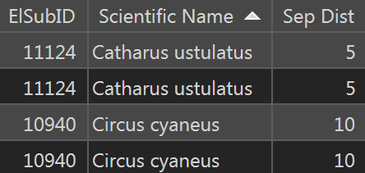
Input Parameters
Points, lines, and polygons being prepped for bulk load
Coordinate system:
Projected into metric coordinate system
Needed fields:
Species identification field
Separation distance in kilometers

Slide 10
Input Parameters
Field selection for species identifier and separation distance fields from input datasets.

Slide 11
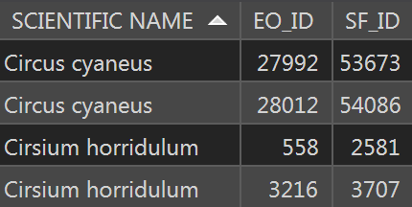
Input Parameters
Existing Biotics EO and SF data
Coordinate system:
Same as input layers
Needed fields:
Species identification field (values must match input data species identification field)
EO ID in EO reps
SF ID in source feature layers

Slide 12
Input Parameters
Field selection for EOID, SFID, and species identifier field from Biotics datasets.

Slide 13
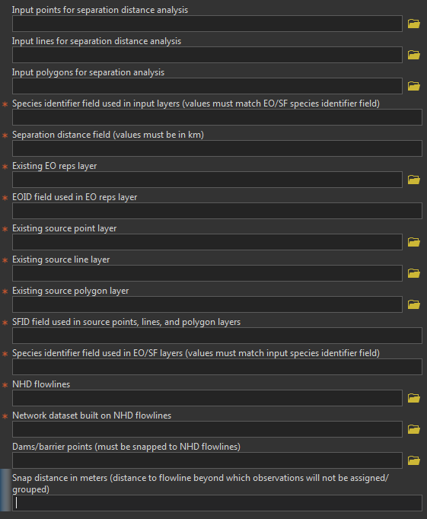
Input Parameters - AQUATIC
NHD flowlines
Network dataset built on NHD flowlines
Must be built before running tool
Dams/barrier points (Optional)
Must be snapped to flowlines before using in tool
Snap distance in meters
Distance beyond which observations will not be assigned an EO/SF group – flagged with null values to QC location.

Slide 14
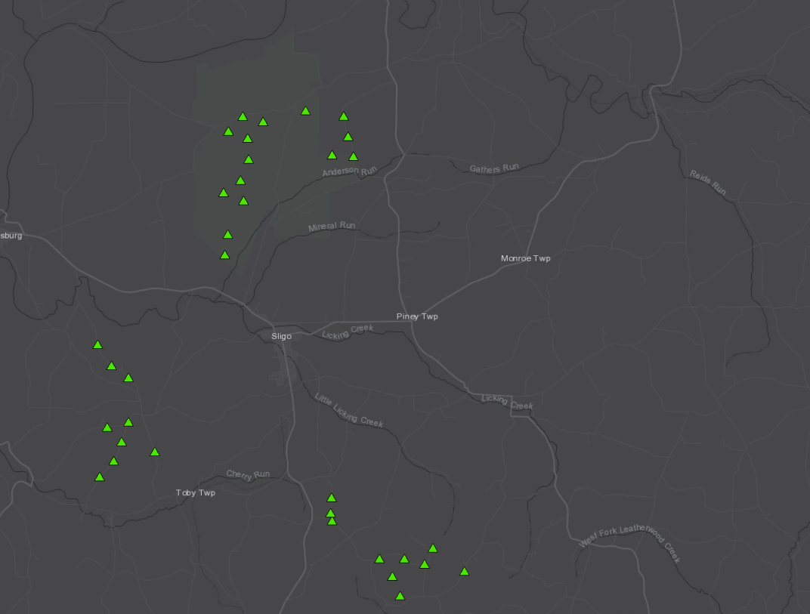
Terrestrial Separation Distance Analysis
Looped selections

Slide 15
Terrestrial Separation Distance Analysis
EO_ID = 10382
Looped selections
ArcPy Cursors
EO_NEW = 1

Slide 16
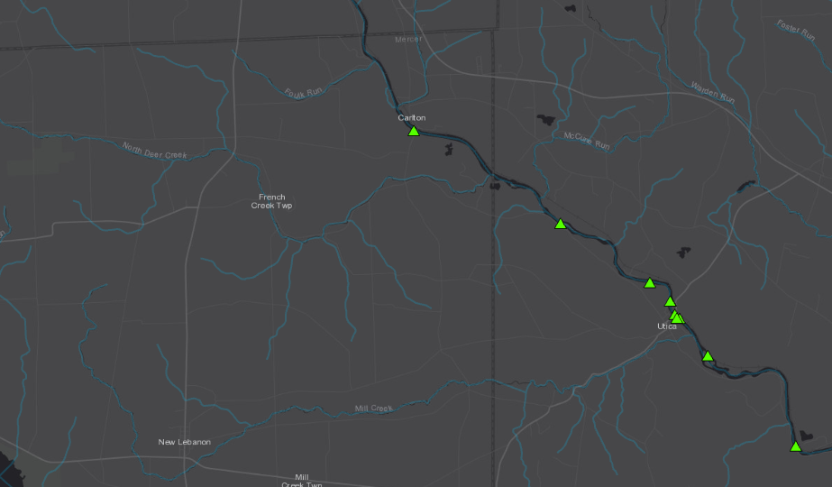
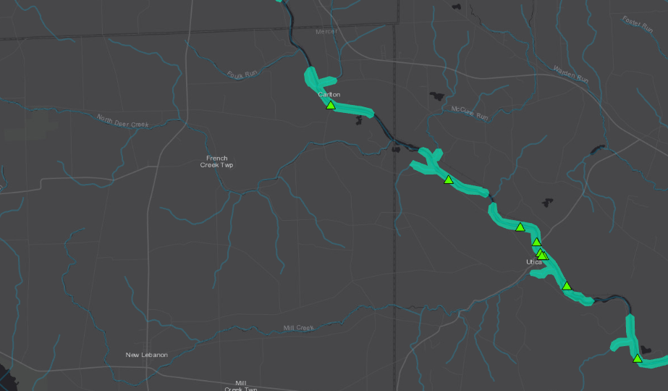
Aquatic Separation Distance Analysis
Network Analyst extension – Service area analyses

Slide 17
Aquatic Separation Distance Analysis
Network Analyst extension – Service area analyses
Spatial joins
EO_ID = 10382
EO_NEW = 1

Slide 18
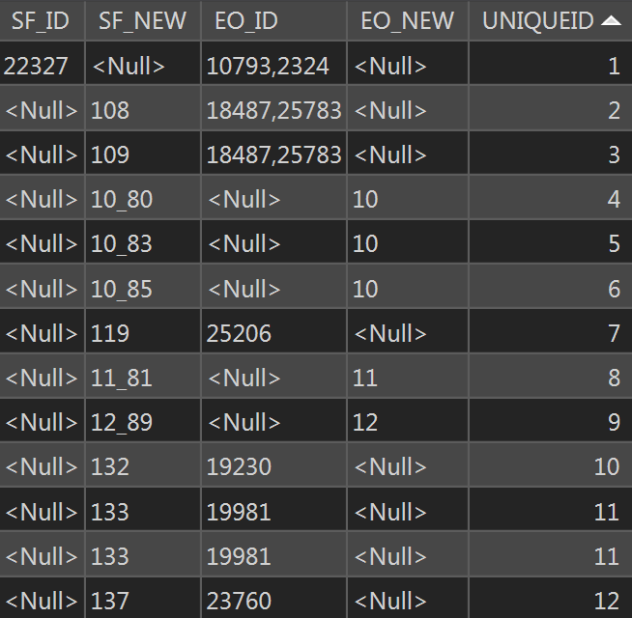
Tool Results
5 appended columns to original input datasets
NOTE: SF_ID and EO_ID assigned multiple IDs if multiple SFs or EOs found within separation distance

Slide 19
Tool Considerations/Limitations
Required software and extensions
Network Analyst extension required for aquatic tool
Built and tested under ArcMap 10.6
Data preparation
Must join separation distance to input datasets
Ensure field schemas match among input data and Biotics data
Must create network dataset for aquatic tool
Must prepare dam layer if including in aquatic analysis
Current limitations
Location use class is not yet considered
Does not distinguish between suitable/unsuitable habitat
No way to automatically distinguish terrestrial separation barriers

Slide 20
Tool Considerations/Limitations
Required software and extensions
Network Analyst extension required for aquatic tool
Built and tested under ArcMap 10.6
Data preparation
Must join separation distance to input datasets
Ensure field schemas match among input data and Biotics data
Must create network dataset for aquatic tool
Must prepare dam layer if including in aquatic analysis
Current limitations
Location use class is not yet considered
Does not distinguish between suitable/unsuitable habitat
No way to automatically distinguish terrestrial separation barriers

Slide 21
Tool Considerations/Limitations
Required software and extensions
Network Analyst extension required for aquatic tool
Built and tested under ArcMap 10.6
Data preparation
Must join separation distance to input datasets
Ensure field schemas match among input data and Biotics data
Must create network dataset for aquatic tool
Must prepare dam layer if including in aquatic analysis
Current limitations
Location use class is not yet considered
Does not distinguish between suitable/unsuitable habitat
No way to automatically distinguish terrestrial separation barriers

Slide 22
https://github.com/PNHP
DataMangement
BulkLoading
BulkLoadPrepToolbox.pyt
BulkLoadPrepToolboxREADME.pdf

Slide 23
Questions?
Molly Moore
Pennsylvania Natural Heritage Program
mmoore@paconserve.org

