Slide 1
Create an EO Rank Change extensible section
Whitney Weber

Slide 2
Request
Create an EO Rank Change extensible section to reflect the SRANK Changes grid in the Subnational Element Tracking record.

Slide 3
Limitations
Unlike the SRANK Changes grid:
The EO Rank Changes extensible section cannot be auto-populated.
The functionality which enables that for the SRANK Changes grid requires application development
It is not controlled by the Oracle database (via a trigger, or any other way) and hence is not feasible within an extensible section. (BX-3531)
The Reference search via the binoculars icon requires application development and is not functionality available in an extensible section.
Furthermore, given the number of references, this wouldn't be possible via a standard dropdown (domain) list as it would significantly impact performance. (BX-5480).
Hence, the appropriate Reference Code will have to be manually entered.

Slide 4
Overview of Solution (with Limitations)
Download the spreadsheet attached to the Solution.
Log into your preferred third-party tool (SQL Developer, SQL Plus, Tora, Toad) as the biotics_dlink user
Create the new domain table
Create the extensible table
Create the extensible section in Biotics
Test the extensible section

Slide 5
Create the domain table
In the 1. Oracle table - Domain Table tab, copy the first SQL statement to create the new Domain table (red text, column B, rows 4 - 14).
Paste the statement into the third-party tool and run it.
Assuming no errors are received, in Biotics, Grant/Refresh Database Privileges.
Copy the remaining SQL statements (red text, column B, rows 17 - 33) into the third-party tool and run them all.
Assuming no errors are received, commit; the changes.

Slide 6
Create the extensible table
In the 1. Oracle table – 1 to n tab, copy the first SQL statement to create the new extensible table (red text, column B, rows 4 - 27).
Paste the statement into the third-party tool and run it. NOTE: If using SQL Plus, remove empty lines from the SQL statement in the 1. Oracle table - 1 to n tab (column B, rows 4 - 27) prior to running it. SQL Plus interprets empty lines as ending the statement (rather than the semi-colon) and will result in an error regarding unknown command. This can be avoided by using SQL Developer, Tora, or Toad.
Assuming no errors are received, in Biotics, Grant/Refresh Database Privileges.
Copy the remaining SQL statements (red text, column B, rows 29 - 53) into the third-party tool and run them all.
Assuming no errors are received, commit; the changes.

Slide 7
Create the extensible section in Biotics
This requires Administrative privileges
In Biotics, from the Configuration menu, choose Extensible Data.
Within the Administer Extensible Data window, from the Filter By: Record Type dropdown menu, select Element Occurrence.
Click the New Record button found in the lower left corner. The Manage Extensible Section dialog opens with the Record Type.
Complete the Manage Extensible Section dialog, as detailed within the Create Extensible Section help topic.

Slide 8
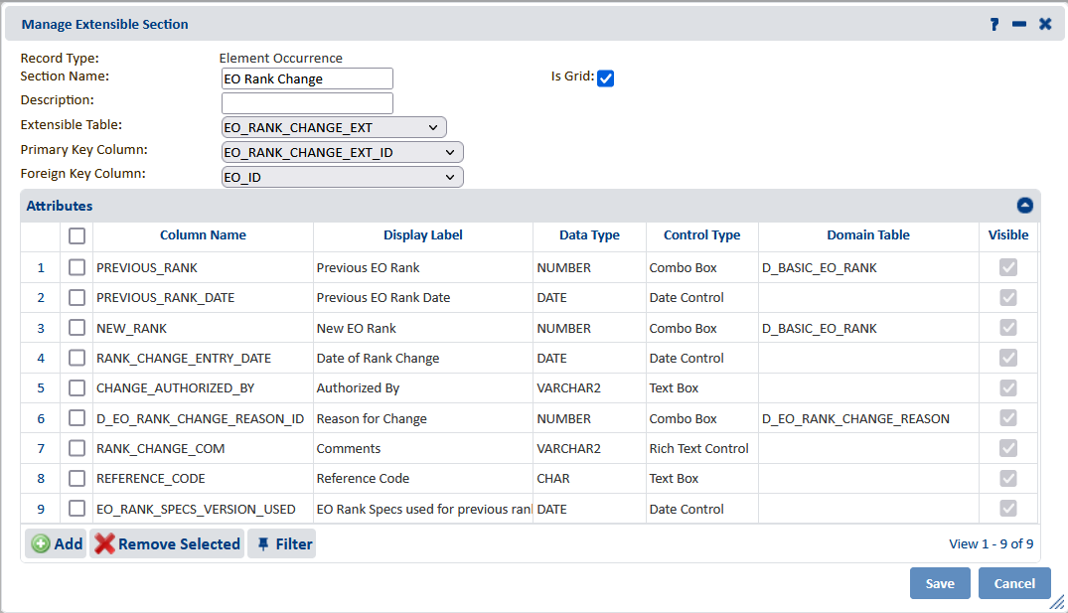
Manage Extensible Section dialog

Slide 9
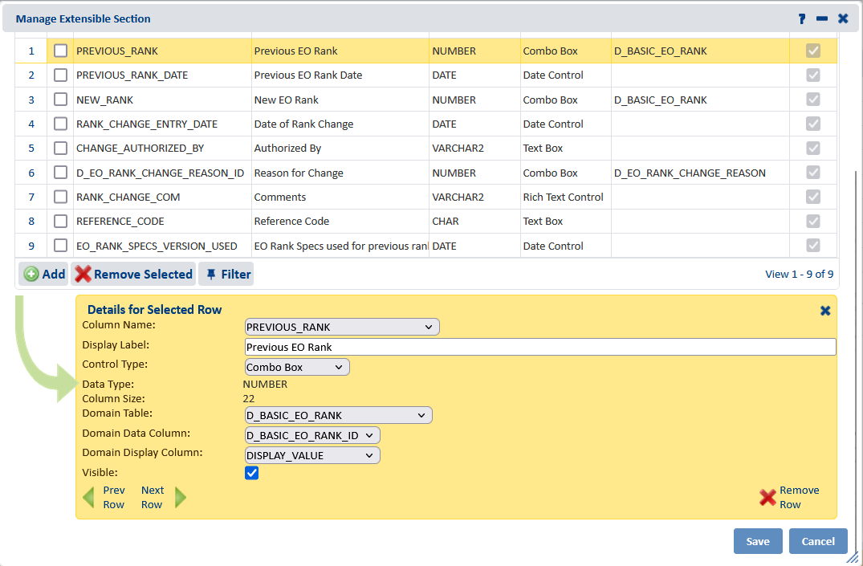
Combo Box details

Slide 10
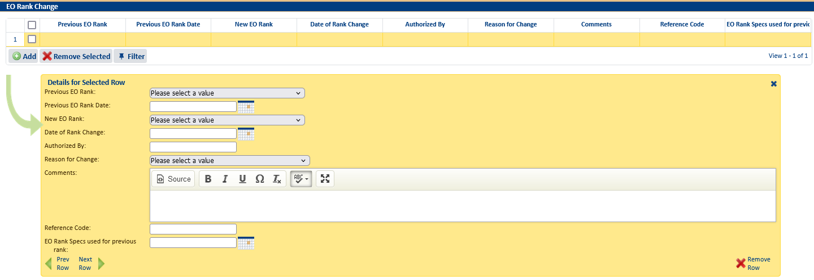
Test the extensible section
Open an EO record and navigate to the EO Rank Change extensible section
Add data to each field and Save the record to verify no errors are received and the section was successfully created
Save the record a second time – some errors are only encountered on the second save!

Slide 11
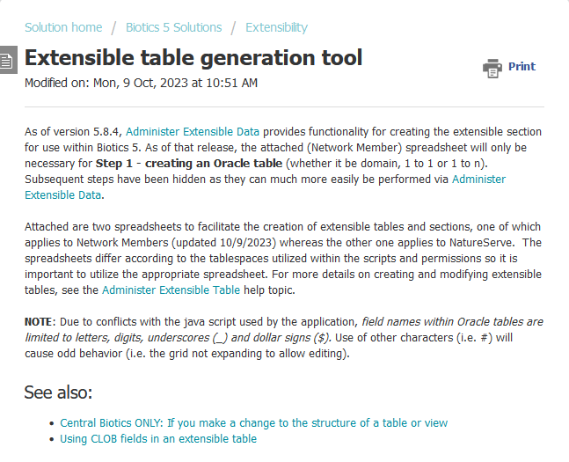
Create your own extensible section
Use the spreadsheet attached to the Extensible table generation tool, on which this solution is based, to create your own extensible section.

