Slide 1
Biotics 5 Pilot testing kick-off call
Tuesday july 31, 2012
2:30 – 4:00 PM EST

Slide 2
Agenda
Accessing Biotics 5 shared instance
What’s in this release
Demo
Online help and support
Test plan
Release schedule
Next steps and discussion
Notes:
Biotics 4
Living with Aging system
Compatibility issues in new environments (Windows, Oracle)
Other common problems (DM comments)
Phasing out Biotics 4 – Support will continue through FY13 and be phased out in FY14 (discuss with Lori)
Four stages;
Market introduction / General Availability (2003- 2004)
Growth/Extended (2004 – 2010)
Maturity (2010 – 2013)
No new versions or patches
Standard support provided (helpdesk and email)
Continued expansion of online information and Knowledgebase
With release of Biotics 5 in 2013 we will enter the last 12 month of this stage
Limited support provided (helpdesk and email)
New environments not certified
Few updates to online information (i.e., Knowledgebase)
Saturation and decline/Retired (2014) – final phase of Biotics 4
Standard helpdesk and email support ends
Access to very limited support through Biotics 4 online help archives

Slide 3
Accessing Biotics 5 Shared Instance
http://bioticspilot.natureserve.org
Password: 123456
Change Password:
https://bioticspilot.natureserve.org/biotics/updatePassword.jsp
British Columbia: bccdc
Michigan: mnfi
Saskatchewan: skcdc
Virginia: vnhp
Wyoming: wyndd
Indiana: inhdc
Ontario: oncdc
New York: nynhp
Texas: txpwd
Yukon: ytcdc

Slide 4
What’s in this release
Release notes available in online help
  Documents features included in release
  Indicates changes and fixes since previous release
  Links to test plans for each release

Slide 5
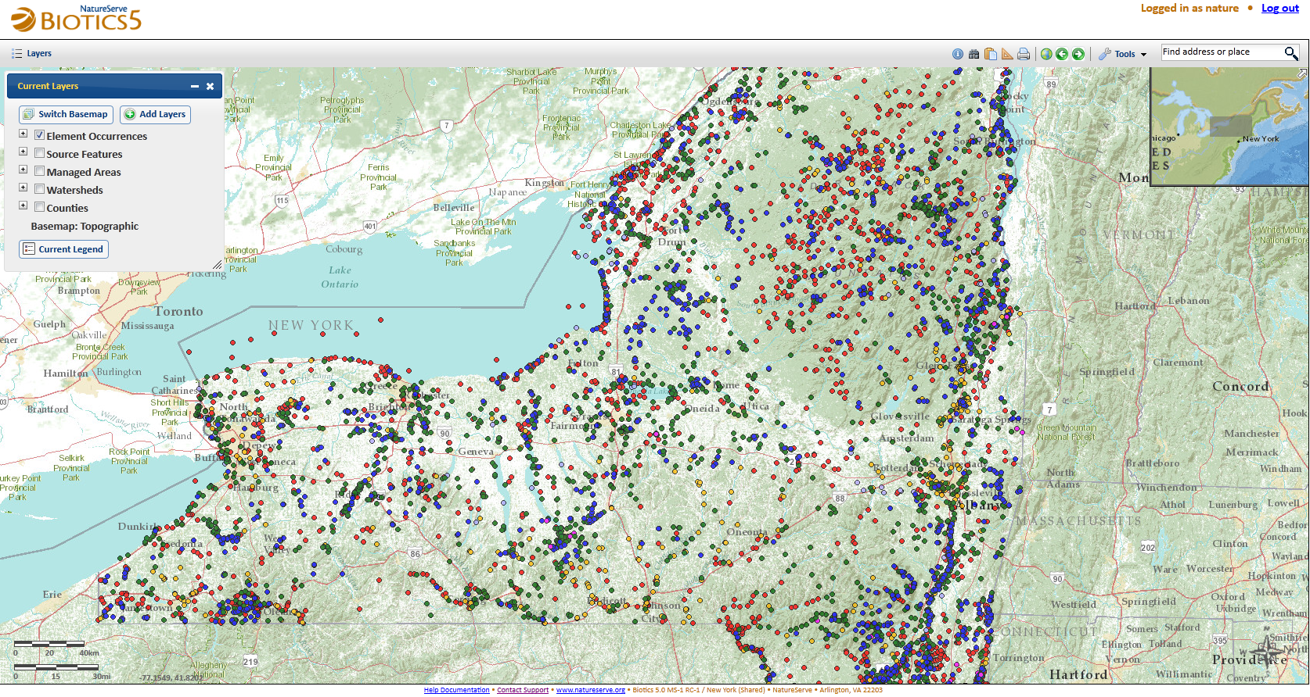
Demo Outline
  Accessing maintenance pages
  Navigating to related records
  Accessing the map viewer
  Initiating map editing tasks

Slide 6
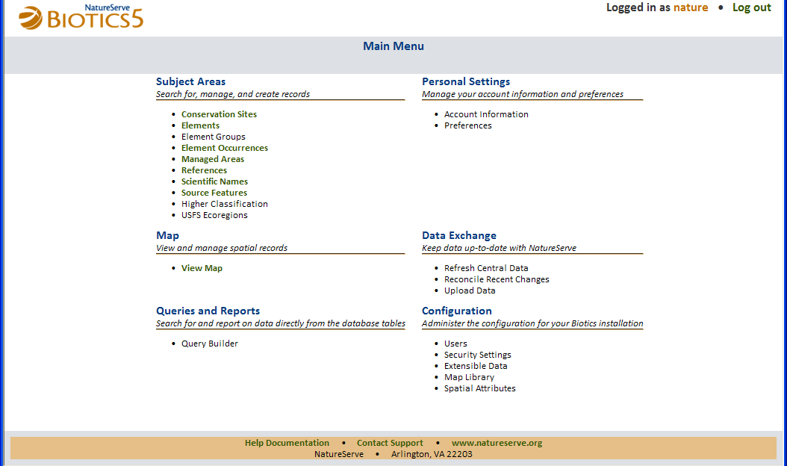
Online Help and Support

Slide 7
How to Access Online Help
Populating initial content is a work in progress
Contents will grow with each new release, as functionality is added
Context sensitive links coming soon

Slide 8
Test Plan
Link to Test Plan available from Online Help and Release Notes
Areas for testing and feedback include:
  Application functionality
  Workflows
  Spatial methodology
Feedback also requested on:
  Testing process
  Conversion process
  Documentation
  Help Desk

Slide 9
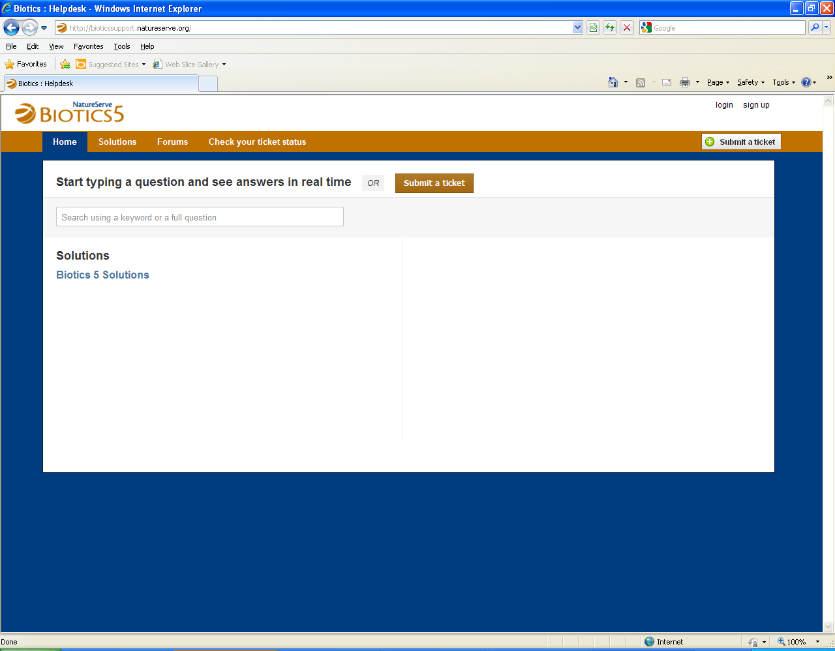
How to Contact Support
http://bioticssupport.natureserve.org
Find a solution
Submit a ticket
Participate in forums
  Announcements
  Tips & Tricks
  Feature Requests
  Discuss a Problem
Issues related to Biotics 4 will continue to be submitted to the existing Biotics 4 Help Desk (http://support.natureserve.org/customer/default.aspx)

Slide 10
Release Schedule
Pilot testing activities will be tied to scheduled releases
A new release will be deployed each month
  Incremental development milestones
  Release notes describe new functionality and link to new test scenarios
  Testing to be completed prior to next release

Slide 11
Upcoming Meeting Schedule
New spatial workflow:
  Wednesday, Aug. 8th
  2:30 – 4:00 PM Eastern
Conversion process:
  Tuesday, Aug. 14th
  2:30 – 4:00 PM Eastern
Future releases: 1st week of each month

Slide 12
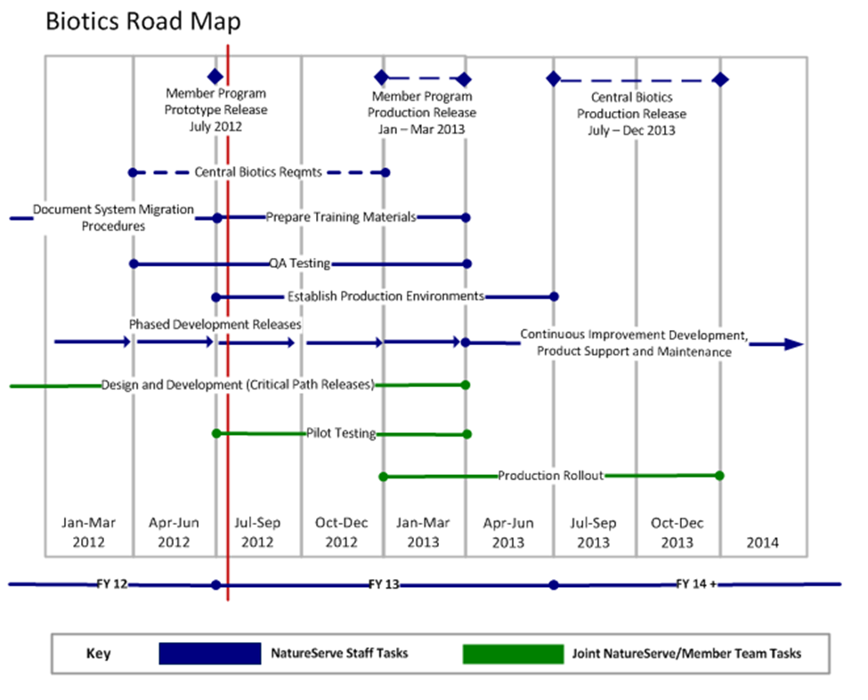
Biotics 5 Road Map
Pilot testing of monthly releases continues through Q1 2013, leading to the full production release

Slide 13
Discussion

