Slide 1
Biotics 5 Prototype testing spatial methodology Wednesday august 8, 2012 2:30 – 4:00 PM EST

Slide 2
Agenda
Updates
What’s new in the spatial model
Spatial workflow
Demonstration of spatial methodology
Discussion and next steps
Notes:
Biotics 4
Living with Aging system
Compatibility issues in new environments (Windows, Oracle)
Other common problems (DM comments)
Phasing out Biotics 4 – Support will continue through FY13 and be phased out in FY14 (discuss with Lori)
Four stages;
Market introduction / General Availability (2003- 2004)
Growth/Extended (2004 – 2010)
Maturity (2010 – 2013)
No new versions or patches
Standard support provided (helpdesk and email)
Continued expansion of online information and Knowledgebase
With release of Biotics 5 in 2013 we will enter the last 12 month of this stage
Limited support provided (helpdesk and email)
New environments not certified
Few updates to online information (i.e., Knowledgebase)
Saturation and decline/Retired (2014) – final phase of Biotics 4
Standard helpdesk and email support ends
Access to very limited support through Biotics 4 online help archives

Slide 3
Updates
Spatial methodology implemented in current release
Location Use Class omitted
Separation Distance hard-coded
Release Notes and Test Plan available in Help Documentation
Notes:
Biotics 4
Living with Aging system
Compatibility issues in new environments (Windows, Oracle)
Other common problems (DM comments)
Phasing out Biotics 4 – Support will continue through FY13 and be phased out in FY14 (discuss with Lori)
Four stages;
Market introduction / General Availability (2003- 2004)
Growth/Extended (2004 – 2010)
Maturity (2010 – 2013)
No new versions or patches
Standard support provided (helpdesk and email)
Continued expansion of online information and Knowledgebase
With release of Biotics 5 in 2013 we will enter the last 12 month of this stage
Limited support provided (helpdesk and email)
New environments not certified
Few updates to online information (i.e., Knowledgebase)
Saturation and decline/Retired (2014) – final phase of Biotics 4
Standard helpdesk and email support ends
Access to very limited support through Biotics 4 online help archives

Slide 4
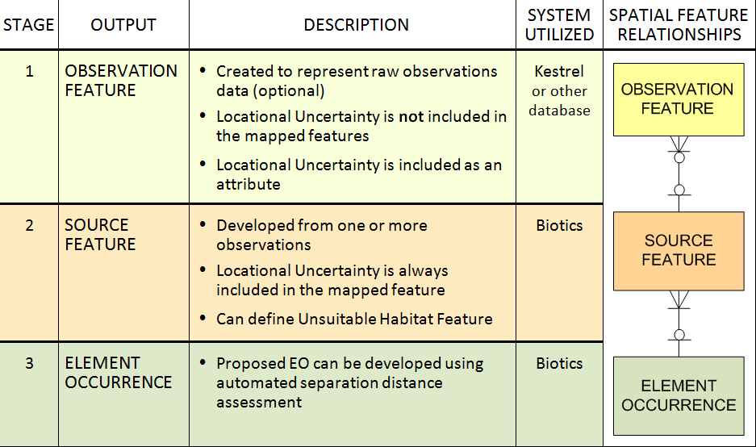
What’s New in the Spatial Model

Slide 5
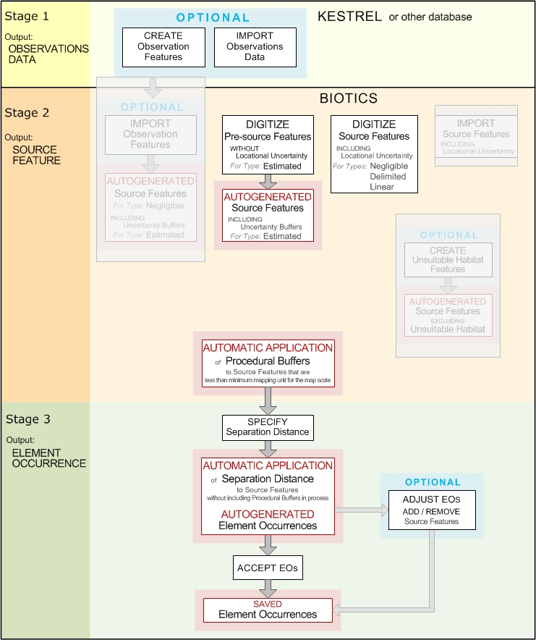
Spatial Workflow

Slide 6
Demo

Slide 7
Go Forth & Test
Provide Feedback in Contact Support:
Workflow effectiveness
Functionality change requests
Other useful scenarios not included in test plan
Observed defects

Slide 8
What’s Next
Next Meeting:
Conversion process
Tuesday, Aug. 14th
2:30 – 4:00 PM Eastern
Future releases: 1st week of each month

Slide 9
Discussion
How are you involving others in your program?
Any other thoughts…

Slide 10
Q & A

